Slide 1
Know/Understand | Do/Skills
IVF & Evaluating claims
LI: Students will understand IVF and will be able to apply this knowledge to evaluate the scientific accuracy and reliability of information.
SC
I can describe the IVF process
I can evaluate scientific claims.
I can justify evaluations using scientific evidence/information.

Slide 2
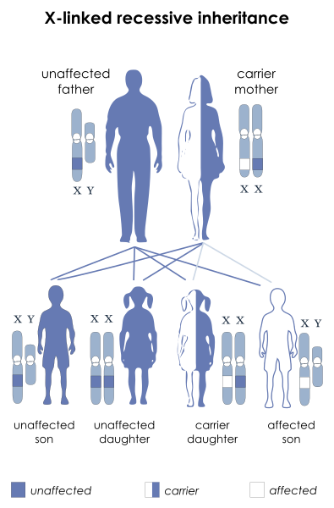
Pedigree review
Normal allele
How many of the couple’s four children are affected by the disorder?
2. What is the ratio of children that are
affected to children that are not?
3. Create a sex linked Punnett square –the abnormality is a recessive trait.
4. What is the chance (percentage) that they will have a boy that is affected?
5. What is the chance (percentage) that they will have a girl that is affected?
Abnormal allele

Slide 3
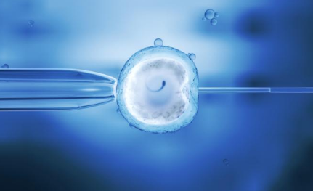
IVF

Slide 5
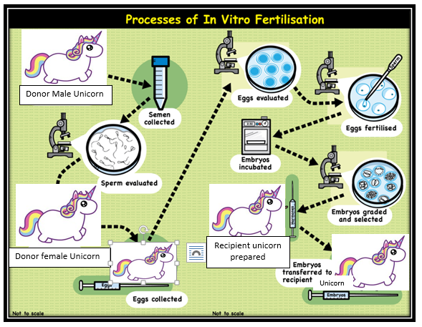
Scientific Claim

Slide 6
Independent practice
A company, MAGICAL UNICORNS, offering IVF services, makes the claim that theirs is the best process for ensuring high-quality magical offspring because they use three gene lines (Father, Mother and Recipient unicorn) in the production of the offspring.
Evaluate this claim for accuracy and reliability. State whether or not you agree with this statement. Justify your response using the information brochure above as scientific evidence, as well as your knowledge of heredity.

Slide 7
Evaluating a claim
Claim
Evaluate
I agree / disagree
because
because
because
Reason 1
Reason 2
Reason 3
Evidence 1
Evidence 2
Evidence 3
Notes:
Students will be provided with scaffolds to choose from including levelled sentence starters and graphic organisers
Students can work independently from the modelled response, collaboratively or with support from the teacher in a guided writing group.

Slide 8
Model answer
The claim from the magical unicorn’s company is inaccurate and unreliable for several reasons.
Firstly, according to the IVF process, the recipient unicorn only acts as a surrogate to carry the offspring and does not contribute it’s genes, as suggested by the claim.
Secondly, according to scientific knowledge of sexual reproduction, the sperm from the donor male unicorn carries a haploid (n) set of chromosomes and the egg from the donor female unicorn carries a haploid (n) set of chromosomes. During fertilisation of the egg with the sperm, the two haploid sets of chromosomes combine to form a diploid zygote. The embryo that develops is therefore diploid. It is not possible for a viable offspring to form from the combination of three haploid sets of chromosomes.
Finally, the claim is unreliable because it is an advertisement from a private company and not from peer reviewed scientific literature.
In conclusion, the claim is therefore inaccurate due to lack of supporting evidence and is from an unreliable source.

Slide 9
Evaluating | Critical evaluation of the accuracy and reliability of claims made in secondary sources with reference to currently held scientific views and the evidence cited. PART B (Q9 & Q10 ) | Informed evaluation of the accuracy and reliability of claims made in secondary sources with reference to currently held scientific views and the evidence cited. PART B (Q9 & Q10 ) | Evaluation of the accuracy and reliability of claims made in secondary sources with reference to currently held scientific views and the evidence cited. PART B (Q9 & Q10 ) | Description of the accuracy and reliability of claims made in secondary sources. PART B (Q9 & Q10 )
Communicating | Concise and coherent communication of science ideas for specific purposes through: Construction of justified evidence-based arguments PART B (Q9 & Q10 ) Discerning selection of appropriate representations and text types OVERALL | Coherent communication of science ideas for specific purposes through: Construction of informed evidence-based arguments PART B (Q9 & Q10 ) Informed selection of appropriate representations and text types OVERALL | Communication of science ideas for specific purposes through: Construction of evidence-based arguments PART B (Q9 & Q10 ) Selection of appropriate representations and text types OVERALL | Communication of science ideas for specific purposes through: Construction of arguments PART B (Q9 & Q10 ) Selection of representations, everyday language and text types OVERALL

Slide 10
Evaluate the following claim for scientific accuracy and reliability.
“Scientific” claim posted on Wikipedia…
Animals can rapidly adapt to change in their environment. If the environment changes, it will only take a generation or so for the species to adapt to the new environment.

Slide 11
Cognitive verbs needed to complete this task.
When writing to Evaluate
Evaluate– consider something or someone to make a judgement of value or worth; often this is supported with evidence. Possible sentence starters When evaluating the given claim.. The evidence in the text states that… There are no valid reasons to support this claim… There are many reasons for… Possible cohesive devices …it can be stated that… …consequently… …as a result… …because… …however…
When writing to Justify
Justify – Showing or proving that a decision, action or idea about something is necessary by giving reasonable reasons for it. When you justify you answer the question ‘why’? and provide evidence to back your decision. Possible sentence starters There are many reasons for… The reasons that support this are… There are no valid reasons to support this… The weight of evidence suggest that… Possible cohesive devices …hence… …add weight to… …as a result… …because… …however… …confirm/confirms…

Slide 12
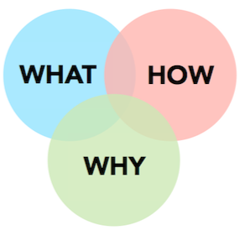
Steps to writing your paragraph…
I can evaluate a scientific claim using science knowledge.
I can justify my evaluation using scientific evidence/information.

Slide 13
Model Response
When evaluating the given claim, it can be stated that it is inaccurate and unreliable and therefore can not be agreed with. There are many reasons for this.
Firstly, the process of evolution takes in between 350000 and 6million years, thus proving that Animals can not simply ‘rapidly adapt’ to changes within their environment.
Secondly, animals evolve key characteristics that make them specialised to their environment. This happens through the process of Natural Selection. For. e.g. In the case of the polar bear, animals born with lighter coloured fur would have had an advantage over darker bears living in the same environment. Over thousands of years, these bears survived and bred on to produce more lightly coloured bears. The environment continued to select the lightest coloured bears (who consequently would have had the best camouflage for hunting) resulting in all polar bears being white in colour. Darwin’s theory of evolution (the theory of natural selection ) states that only the animals with the best adaptations will be selected to survive.
In conclusion, the claim is inaccurate because it does not reflect current scientific theories. Animals can not rapidly adapt to environmental changes, as the processes of evolution and natural selection take hundreds of thousands of years. In addition, the claim is also unreliable because it comes from Wikipedia, which is not a trusted source.

Slide 14
Evaluate the claims below for scientific accuracy and reliability. State whether or not you agree with the statement. Justify your response using knowledge and evidence.
Evolution is a gradual process that occurs over time. The key features that enable Evolution are Natural Selection, Excess Production of offspring and Variation.
Source: Scientific Journal
You can make super humans if you combine the DNA of three people. 69 chromosomes are better than 46!
Source: Wikipedia

Slide 15
Know/Understand | Do/Skills
Were you successful?
LI: Students will understand IVF and will be able to apply this knowledge to evaluate the scientific accuracy and reliability of information.
SC
I can describe the IVF process
I can evaluate scientific claims.
I can justify evaluations using scientific evidence/information.
What do I need to do to evaluate a claim more effectively?

