Slide 1
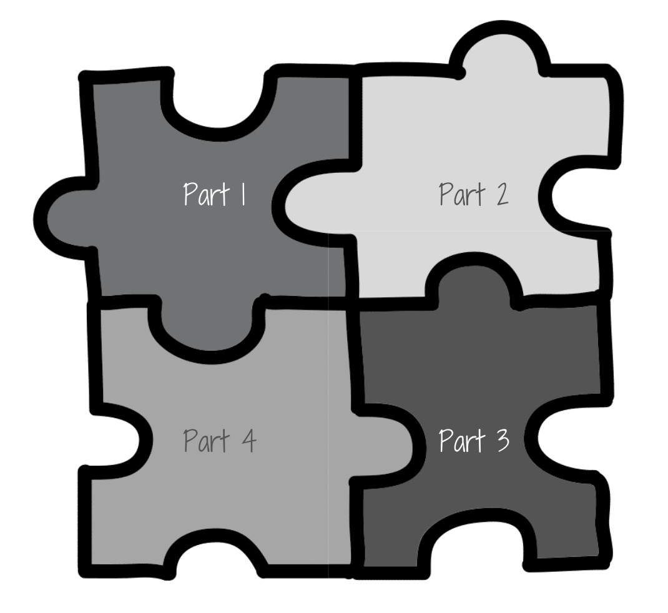
Jigsaw Activity
The Shift to Student-Led | Catlin R. Tucker and Katie Novak

Slide 2
Part/Topic 1
Part/Topic 2
Part/Topic 3
Part/Topic 4

Slide 3
Part/Topic #1:
[Student Name]

Slide 4
Part/Topic #2:
[Student Name]

Slide 5
Part/Topic #3:
[Student Name]

Slide 6
Part/Topic #4:
[Student Name]

Slide 7
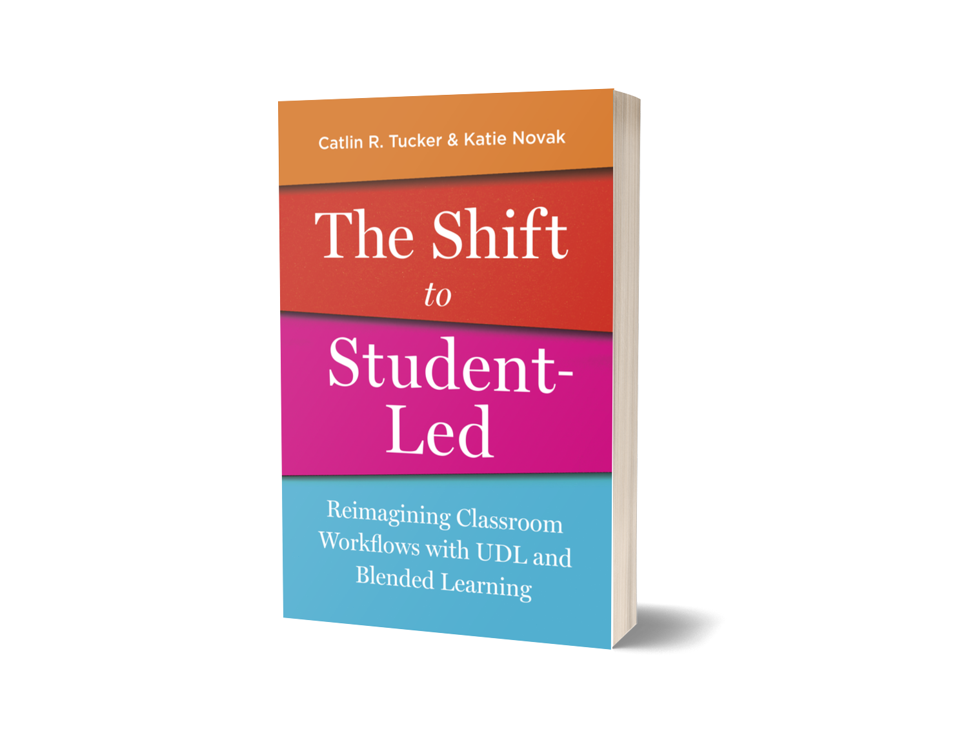
Discover more templates, strategies and tips on how to help your students lead their learning..
Professional Development | Workshops | Resources
The Shift to Student-Led | Catlin R. Tucker and Katie Novak

